Slide 1



Information Communication Technology
(CSC101)
Lecture 11
Instructor: Mariam Fiaz
email: mariamsherwani434@gmail.com

Slide 2


Reference Books:
  Computer Science Illuminated – Nell Dale & John Lewis, Jones & Bartlett Learning, LLC, 2020 (Read Chapter 6)

Slide 3
Topic: Problem Solving, Pseudocode & Flowcharts (Sequential Structure and Decision Structure)
Contents:
Problem Solving in Programming
Sequential Structure
Pseudocode
Flowcharts
Decision Structure
Examples (Sequential & Decision)
Discussion & Practice using Pseudocode (Sequential & Decision)
Generating Flowcharts (Sequential & Decision)
Advantages of Pseudocode and Flowcharts
Summary

Slide 4
Problem Solving in Programming:
Problem solving in programming means understanding a problem and creating a clear step-by-step solution using logic.
The problem-solving process typically involves:
• Problem analysis (understanding requirements).
• Solution design (developing an algorithm).
• Representation (pseudocode or flowchart).
• Implementation (coding in a programming language).

Slide 5
Sequential Structure:
Sequential structure is the simplest control structure in programming.
In this structure, instructions are executed in a fixed order, one after another, without any branching or decision-making.
Example:
Start → Input values → Perform calculation → Display result → End
Key Point:
Execution strictly follows the written sequence of steps.

Slide 6
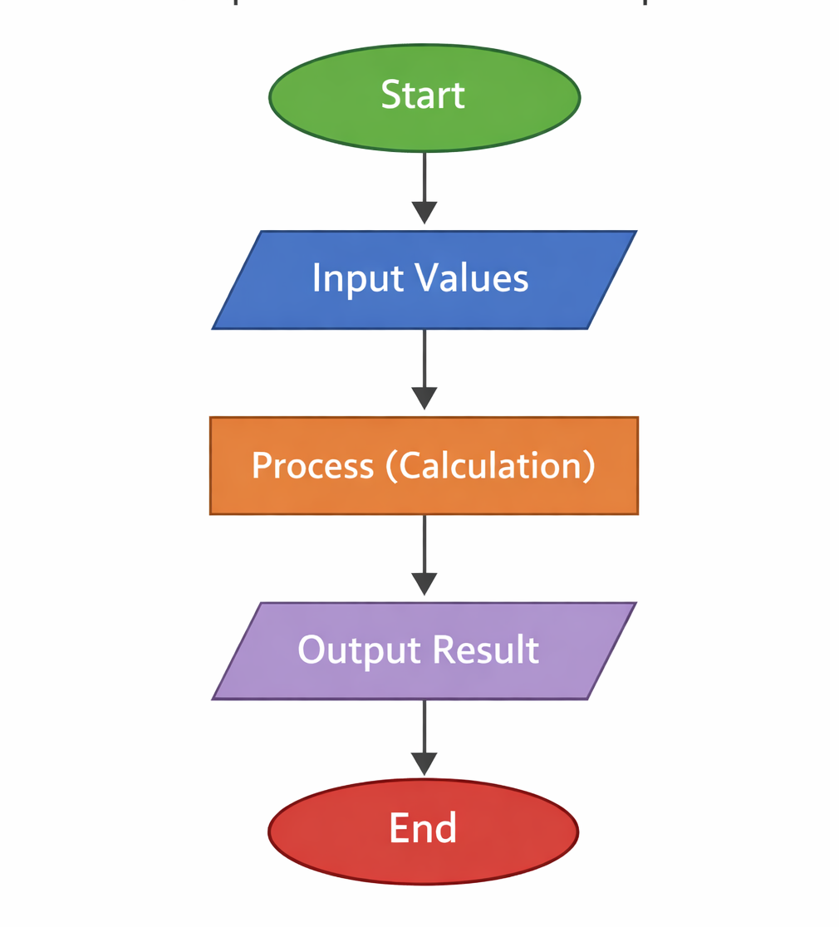

Slide 7
Pseudocode:
Pseudocode is a simple way of writing the steps of a solution using easy English-like statements.
It is not a programming language, but it provides a clear description of program logic independent of syntax.
Characteristics:
• Uses simple, readable statements
• Focuses on logic rather than syntax
• Language-independent representation
Example:
START INPUT A INPUT B SUM = A + B PRINT SUM END

Slide 8
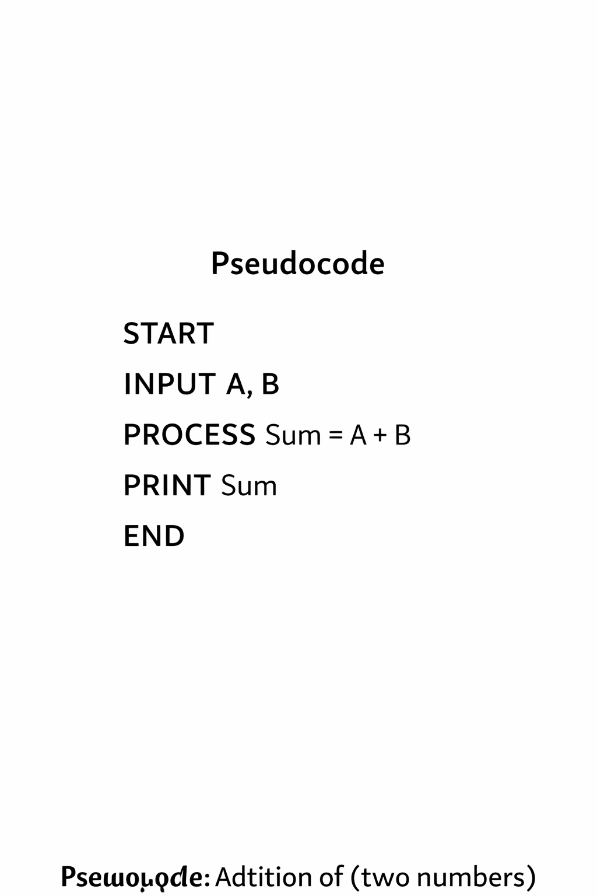

Slide 9
Flowcharts:
A flowchart is a diagram that shows the steps of a solution using simple symbols and arrows.
Common Symbols:
• Oval → Start/End
• Parallelogram → Input/Output
• Rectangle → Process
• Diamond → Decision
• Arrow → Direction of flow
Flowcharts provide a visual representation of the sequence and logic of operations.

Slide 10
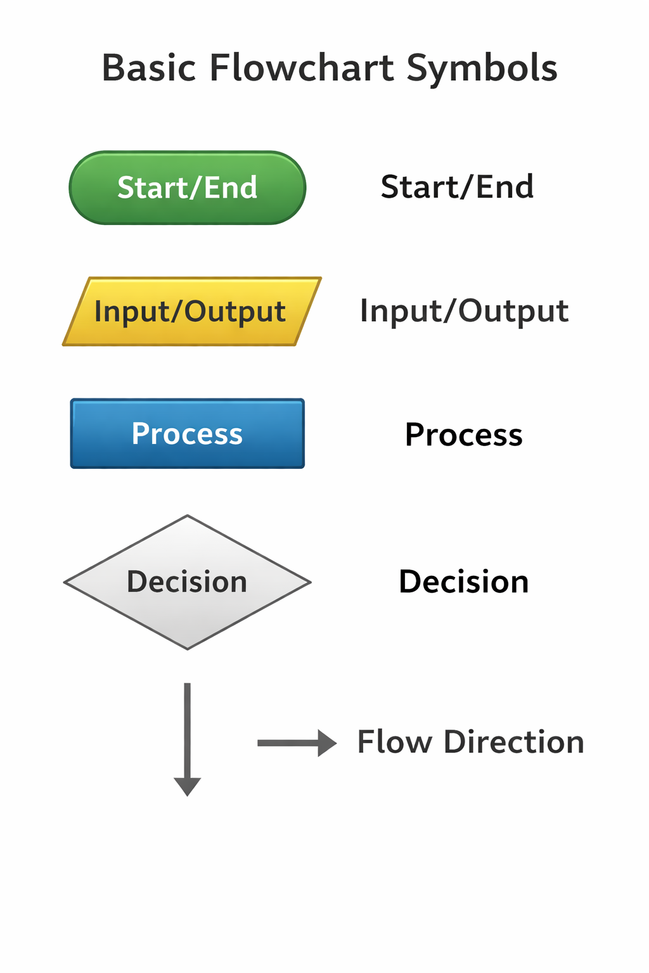

Slide 11
Decision Structure:
Decision structure allows a program to choose between different paths based on a condition.
It is commonly implemented using IF–ELSE constructs.
Example:
IF marks ≥ 50 THEN PRINT “Pass” ELSE PRINT “Fail”
Key Point:
Program execution follows different paths depending on the evaluation of a condition.

Slide 12
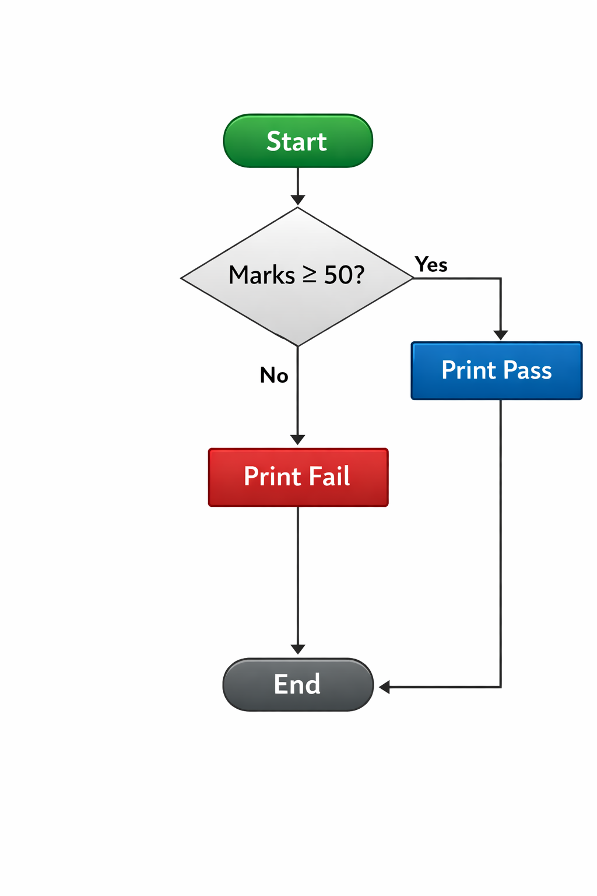

Slide 13
Examples (Sequential & Decision):
1. Sequential Example (Addition)
Pseudocode:
START INPUT A INPUT B SUM = A + B PRINT SUM END
Flow Representation:
Start → Input → Process → Output → End

Slide 14
Examples (Sequential & Decision):
2. Decision Example (Even/Odd)
Pseudocode:
START INPUT N IF N MOD 2 = 0 THEN PRINT “Even” ELSE PRINT
“Odd” END
Flow Representation:
Start → Input → Decision → Output → End

Slide 15
Discussion & Practice using Pseudocode (Sequential & Decision):
Pseudocode is used to represent problem-solving procedures in a structured and logical form prior to implementation.
(A) Sequential Structure Practice
Sequential problems are expressed as a series of ordered steps.
Example (Area of Rectangle):
START INPUT Length, Width Area = Length × Width PRINT Area END

Slide 16
Discussion & Practice using Pseudocode (Sequential & Decision):
(B) Decision Structure Practice
Decision problems involve conditional evaluation and branching.
Example (Positive or Negative):
START INPUT Number IF Number ≥ 0 THEN PRINT “Positive” ELSE PRINT “Negative” END

Slide 17
Generating Flowcharts (Sequential & Decision):
Flowcharts are constructed to visually represent algorithms using standardized symbols.
(A) Sequential Flowchart
Represents a linear sequence of operations.
Example:
Start → Input A, B → Process (A + B) → Output Result → End

Slide 18
Generating Flowcharts (Sequential & Decision):
(B) Decision Flowchart
Represents conditional branching using decision symbols.
Example:
Start → Input Marks → Decision (Marks ≥ 50?) → Yes → Print Pass → No → Print Fail → End

Slide 19
Advantages of Pseudocode and Flowcharts:
• Provide clear representation of program logic.
• Facilitate structured program design.
• Reduce logical errors before implementation.
• Improve communication among developers.
• Support debugging and maintenance.

Slide 20
Summary of Lecture
Problem solving in programming involves the development of logical and structured solutions. Sequential structures execute instructions in order, while decision structures enable conditional branching. Pseudocode and flowcharts serve as essential tools for representing algorithms clearly before implementation.

